Slide 1

ROC Analysis on Predicting Loan Possession
Yavuz numan karabiyik

Slide 2
The data is related with direct marketing campaigns of a Portuguese banking Institution.
Based on phone calls and ask;
Age
Job
Martial status
Education
Bank account balance
Loan possession etc.
Actual Classification goal = to predict if the client will subscribe a term deposit or not
Output variable -> - y - has the client subscribed a term deposit? (binary: “yes” or “no”)
My Classification goal = to predict if the client will be able to possess loan or not.
Output variable -> - loanyes - has the client possess a loan or not? (binary: “1” or “0”)
Data explanation

Slide 3
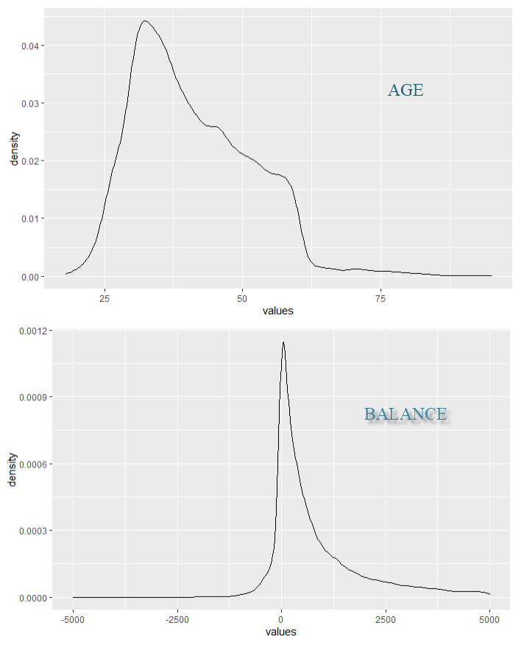
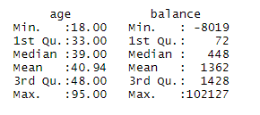
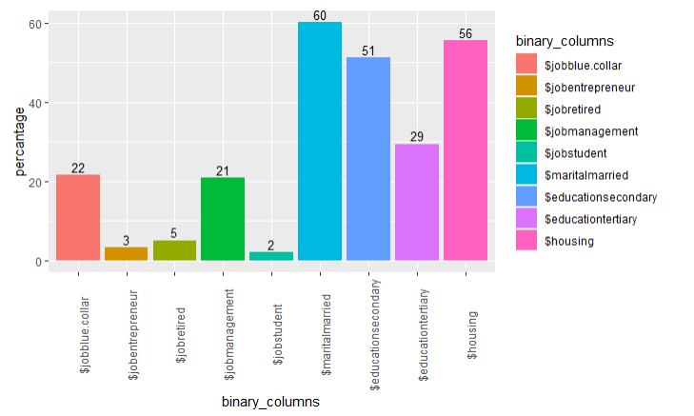
Used binary(one hot decoder) and non-binary features to do prediction
Age
Balance
Job Type
Martial Status
Education Level
House Possession
features

Slide 4
Predict loan possessions of the bank customers considering features such as age, bank balance, job type, martial status with classifiers;
Logistic Regression
Conditional Inference Trees
Decision Tree
Answer the question: Which Classifier perform the best performance predicting loan possessions of the bank customers with given features?
Research question

Slide 5
Used ROC Analysis to compare different classifier models to find the most performant classifier predicting loan possessions of the bank customers
ROC (Receiver Operating Characteristic) Curve is a way to visualize the performance of a binary classifier.
TPR or True Positive Rate answers the question — When the actual classification is positive, how often does the classifier predict positive?
FPR or False Positive Rate answers the question — When the actual classification is negative, how often does the classifier incorrectly predict positive?
The ROC curve is the graph plotted with TPR on y-axis and FPR on x-axis for all possible threshold. Both TPR and FPR vary from 0 to 1. Therefore, a good classifier will have an arc/ curve and will be further away from the random classifier line.
To quantify a good classifier from a bad one using a ROC curve, is done by AUC (Area under Curve).
METHOD EXPLANATION

Slide 6
The data is used to predict loan possessions of the bank customers considering features such as age, bank balance, job type, martial status with 3 different classifiers;
Logistic Regression
Conditional Inference Trees
Decision Tree
They all performed differently while
Logistic Regression performed %67 accuracy
Logistic Regression performed %70 accuracy
Logistic Regression performed %61 accuracy
We got similar results in ROC Curves.
DATA SATISFACTION

Slide 7
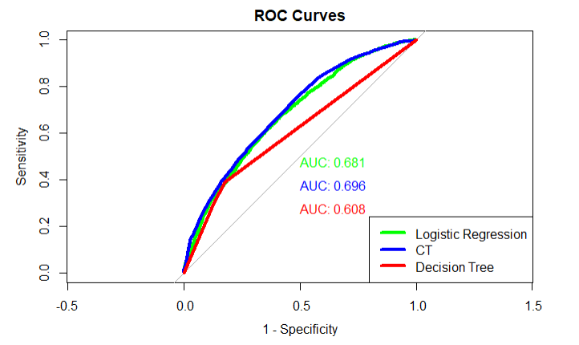
From the graph it is quite clear that a good classifier will have AUC higher than a bad classifier as the area under curve will be higher for the former.
AUC is also visible making Conditional Inference Trees a slightly better than other classifiers Logistic Regression, and Decision Tree Classifier.
Interpretation(conclusion)

Slide 8
QUESTIONS?
THANK YOU FOR LISTENING

